Slide 1

Benchmarking ML and DL Architectures for Imbalanced Credit Card Fraud Detection
Hodor Alexandru-Rafael
IMA
ACE - UCV

Slide 2
The Core Challenge: Extreme Imbalance
Dataset Source European cardholder transactions (2013) found on kaggle
Extreme Imbalance 0.173% fraud rate, only 492 fraudulent cases out of 284,807 total transactions
The "Accuracy Trap" Standard accuracy is a deceptive metric in this context; a 99.8% score can be achieved by simply predicting "No Fraud" for every case
Primary Metric (AUPRC) Area Under the Precision-Recall Curve is adopted as the primary success factor to isolate the minority class signal from the majority class "noise"

Slide 3
Deep Learning Methodology (MLP)
Network Architecture A three-layer Multi-Layer Perceptron using a 32-16-1 neuron structure with ReLU and Sigmoid activations
Optimization Strategy Adam Optimizer paired with a custom Focal Loss function featuring a gamma of 2.0 and alpha of 0.25
The Focal Loss Advantage This custom loss function acts as the project's secret sauce by forcing the network to prioritize hard fraudulent cases rather than being overwhelmed by millions of easy legitimate ones
Regularization Techniques Integration of Dropout layers and feature clipping within a -5 to 5 range to mitigate the impact of PCA outliers

Slide 4
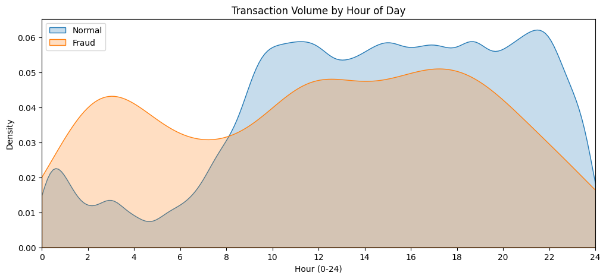
Exploratory Data Analysis (EDA) Highlights
Circadian Rhythms Legitimate transactions follow human sleep/wake cycles, fraud is flatter across 24 hours.

Slide 5
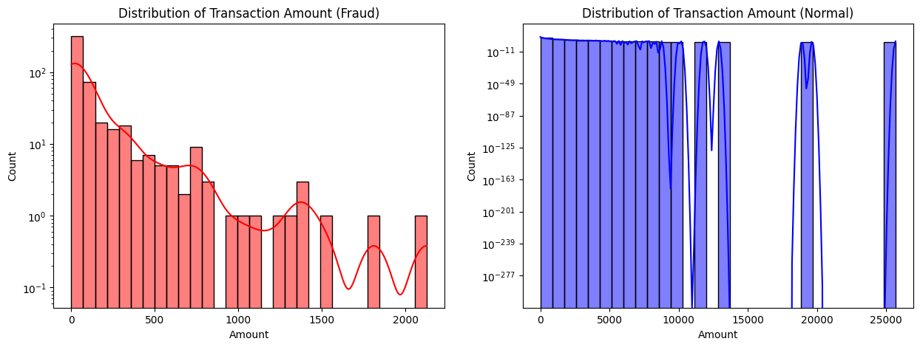
Exploratory Data Analysis (EDA) Highlights
Transaction Value Fraud tends to cluster in smaller denominations to avoid "limit-based" triggers.

Slide 6
Data Environments & Resampling Strategies
Anomaly-Filtered Environment Evaluation on the initial dataset after using Isolation Forest to identify and handle outlier distributions
Random Under-Sampling Implementation of RUS to balance classes by removing majority instances based on the IF-cleaned distribution
Synthetic Minority Over-sampling Application of SMOTE to generate artificial fraud instances between existing minority data points within the filtered feature space
The Generalization Hypothesis Testing whether synthetic data generation helps models find better decision boundaries or simply introduces mathematical noise that compromises precision

Slide 7
Benchmarking Suite: The 10 Competitors
Statistical Baselines Implementation of Logistic Regression with liblinear solver and Linear SVC to establish fundamental linear performance
Standard and Balanced Ensembles Utilization of Decision Trees and Random Forests alongside a specialized Balanced Random Forest integrated with Isolation Forest logic
Gradient Boosting Frameworks Evaluation of standard Gradient Boosting, XGBoost with log-loss optimization, and LightGBM to measure state-of-the-art ensemble efficiency
Neural Network Implementation Deployment of a custom Multi-Layer Perceptron architecture developed specifically for imbalanced fraud detection
Hyperparameter Optimization Inclusion of a Random Forest model tuned via an automated pipeline and Grid Search to establish a peak performance ceiling

Slide 8
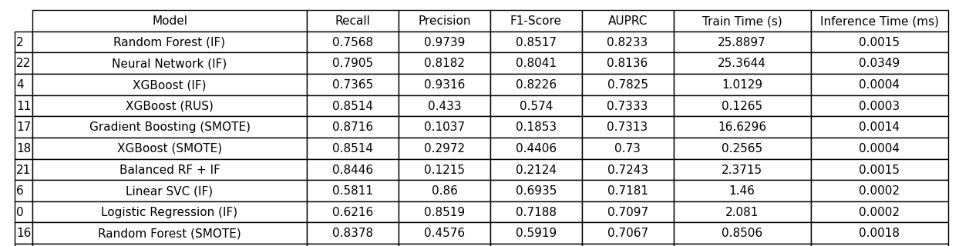
Results: The AUPRC Leaders
Winner: Random Forest (IF)
Runner-up: Neural Network (IF)
High Efficiency: XGBoost (IF)
The Precision vs. Recall Trade-off
Standard Data High Precision (0.97), Moderate Recall (0.75)
SMOTE/RUS Data High Recall (0.87), Low Precision (0.06)

Slide 9
The "Operational Champion": XGBoost
Top-Tier Accuracy Consistently ranked in the top three for AUPRC, delivering high-performance fraud detection
Rapid Training Scalability Training completed in just 1.01 seconds, making it 25 times faster to update than Neural Networks or Random Forests
Ultra-Low Inference Latency Predictions delivered in 0.0004 ms, providing near-instantaneous decision-making at the point of sale
The Neural Network Penalty The MLP is roughly 80x to 100x slower at inference than XGBoost, creating massive CPU overhead in high-volume environments
The Real-World Winner XGBoost is the operational champion because its speed allows for frequent model retraining without requiring expensive hardware upgrades

Slide 10
Conclusion & Future Improvements
Peak Accuracy: Random Forest (IF) for minimizing false positives
Maximum Fraud Capture: Logistic Regression (SMOTE) for aggressive recall
Architectural Balance: Neural Network (IF) for deep learning stability
Operational Scalability: XGBoost (IF) for high-frequency environments
The "No Free Lunch" Principle High Recall and high Precision exist in a constant trade-off where maximizing one typically compromises the other
Research Limitations The study is constrained by a static dataset and the absence of behavioral features due to PCA-anonymization
Future Methodology Development of Hybrid Stacking models and integration of Explainable AI using SHAP or LIME for model transparency

Slide 11
Thanks for your attention!
Questions?

